Slide 1



Classes
jApp inherits Panel
Provides Application Interface
jToolBar(ToolStrip)
jMenuBar(MenuToolStrip)
jSplitBoxContainer(jPanel)
jStatusBar(StatusStrip)
Theme able ToolBar with generic Item/ItemGroups/Events
Themeable MenuBar with generic builder for Item/ItemGroup/Events
Manages Sizable 3x2 grid of objects inheriting from jBox
Themeable StatusBar with generic builder for Item/Events
jBoxItem(jPanel)
jBox(jPanel)
Item Config and Status
Contains and Manages 0-n jBoxItem’s
jBoxItem Child Classes
jDockBox(jBox)
jTabDockBox(jBox)
jTrayDockBox(jBox)
jBoxItemGedComViewer
jBoxItemIndividualViewer
jBoxItemTimelineViewer
jBoxItemMediaViewer
jBoxItemMediaEditor
jBoxItemNoteEditor
jBoxItemPersonSummary
jBoxItemWebViewer
jBoxItemMessaging
jBox View
Display Items in a Docked Format
jBox View
Display Items in Tabbed Document Format
jBox View
Display Open/Unpinned Items in Try Format
jTable
jListBox
jPanel(Panel)
Themeable Table
Themeable Listbox
Provides Custom Border Size/Color
jSearchTextBox(TextBox)
jIcon
Generic Search box /w Icon & Text
Icon with Size, Color controls
jTheme
jProperties
Provides Icon, Image, and Colors for entire App
Provides Read/Write of property files. Used for saving settings.
GedCom
AncestryGedCom(GedCom)
Data File support for GEDCOM files. Open/Insert/Update/Delete/Save
GEDCOM Functionality with Ancestry extended attribute support
jWeb(WebView2)
AncestryMessages
AncestryAPI
Provides a clean consistent web interface and status events
Message Notification Support for Ancestry Messages
Paths, Parsing, Login handling to simulate a real RestAPI

Slide 2
jBox Class
jApp
inherits Panel
Properties
hasFocus Boolean
BoxLocation JBoxLocation
ItemKeys Collection(Of String)
Items Collection(Of JBoxItem)
ReadOnly SelectedItem JBoxItem
ReadOnly SelectedIndex Integer
Methods
SelectItem(key)
RemoveItem(key)
AddItem(key, JBoxItem)
CloseItem(key)
PinItem(key)
UnPinItem(key)
Events
ItemClosed(BoxLocation,ItemKey)
ItemOpened(BoxLocation,ItemKey)
ItemSelected(BoxLocation,ItemKey)
GotFocus(BoxLocation, ItemKey)
jBox
inherits Panel
Properties
hasFocus Boolean
BoxLocation JBoxLocation
ItemKeys Collection(Of String)
Items Collection(Of JBoxItem)
ReadOnly SelectedItem JBoxItem
ReadOnly SelectedIndex Integer
Methods
SelectItem(key)
RemoveItem(key)
AddItem(key, JBoxItem)
CloseItem(key)
PinItem(key)
UnPinItem(key)
Events
ItemClosed(BoxLocation,ItemKey)
ItemOpened(BoxLocation,ItemKey)
ItemSelected(BoxLocation,ItemKey)
GotFocus(BoxLocation, ItemKey)
Public Event AppClose()
Public Event AppWinMinimized()
Public Event AppWinRestored()
Public Event AppWinMaximized()
Public Event AppWinResized()
Public Event AppMenuClicked(MenuItemKey As String)
Public Event AppMenuCheckedChanged(MenuItemKey As String, Checked As Boolean)
Public Event AppMenuEnabledChanged(MenuItemKey As String, Enabled As Boolean)
Public Event AppToolbarButtonClicked(MenuItemKey As String)
Public Event AppToolbarButtonCheckedChanged(MenuItemKey As String, Checked As Boolean)
Public Event AppToolbarButtonEnabledChanged(MenuItemKey As String, Enabled As Boolean)
Public Function AddMenuItemSeperator(parentKey As String) As ToolStripSeparator
Public Function AddMenuItem(Key As String, text As String, Optional parentKey As String = "", Optional iconKey As String = "") As ToolStripMenuItem
Public Function AddToolbarButton(Key As String, iconKey As String, Optional toolTip As String = "") As ToolStripButton
Friend Sub AddBoxItem(Item As Control)
Friend Sub HideBoxItem(ItemKey As String)
Friend Sub HideBox(BoxLocationId As BoxDockLocation)
Friend Sub ShowBox(BoxLocationId As BoxDockLocation)
Friend Sub AddDocBoxItem(ItemKey As String, ItemObject As Object)
Friend Sub RemoveDocBoxItem(ItemKey As String)
Friend Sub MoveBoxItem(ItemKey As String, FromBoxLocationId As BoxDockLocation, ToBoxLocationId As BoxDockLocation)

Slide 3
Control
mainPanel – Dock=Fill
headerPanel – dock=top
toolPanel – Dock=top
searchPanel – Dock=top
clientPanel – Dock=fill
tabPanel – Dock=Bottom

Slide 4
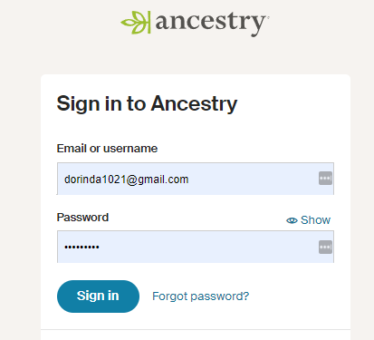
<title>Sign in to Ancestry</title>
/account/signin?returnUrl=

Slide 5
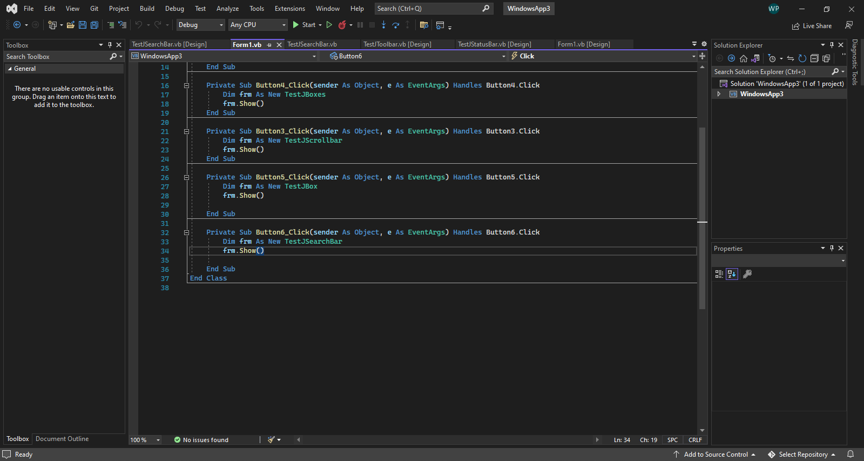
jApp - Design
JIcon
JMenuBar
JFormControlBox
Usage Requires My.jAppEngine
Properties
Methods
Events
AppLostFocus
AppGotFocus
AppToolbarItemClicked(ItemID)
AppMenuItemClicked(ItemID)
AppGetSetting(Id)
AppSaveSetting(id, value)
AppClose(byRef cancel)
AppSearch(Criteria)
AppShowBox(boxID)
AppHideBox(boxID)
AppCloseBox(boxID)
JToolbar
JPanel
jSplitBoxContainer
JStatusBar
Methods
For MenuBar/ToolBar/StatusBar
Add{Bar}{ObjectType} – Creates the Objects, adds it and returns a reference for special configuration
Remove{Bar}{ObjectType} – Removes a specific item and its children
Get{Bar}{ObjectType} – Returns a reference to a specific object
Enable/Disable – Enables and Disables
Target
Client Area
jSplitBoxContainer

Slide 6
jSplitBoxContainer - Design
S1P1
S1P2
S1P1/S3P2 should not automatically resize or grow on Maximize.
Both also need to have minimum sizes set and inforced.
Splitter widths need to also be saved and restored on reload.
Active Docked Items should retain their visibility and home.
Open items in Tabbed area also need to save/restore.
Should create a serializable structure just for this objects settings.
S2P1
TL
S3P1
S3P2
S4P1
TM
S5P1
TR
jBoxItem
jBoxItem
jBoxItem
S2P2
BL
S5P2
BR
S4P2
BM
APP.TOP/LEFT/HEIGHT/WIDTH
S#.HEIGHT/WIDTH/SPLIT/P1Collapse/P2Collapse
jBoxItem
jBoxItem
jBoxItem

Slide 7
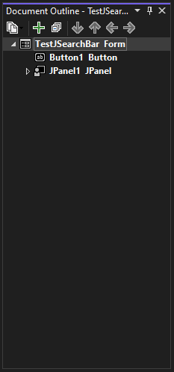
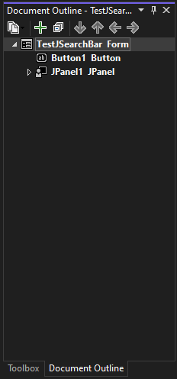
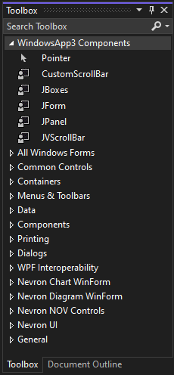
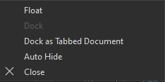
jBox(jBoxItem) – Design Ideas
UnFocused
Focused
Context Menu
Client Area
jBoxClientItem
Client Area
jBoxClientItem
Client Area
jBoxClientItem
Single Child
Multi Child
2nd Selected
Multi Child
1st Selected

Slide 8
jBox(jBoxItem) - Design
Caption
ControlBox
JPanel
JBoxTabs is hidden with only 1 Client
>1 Client, then tabs become active
Caption works dragable header, where
JBoxClients can be moved between Boxes
Each Client sets:
Caption
Jtoolbar Content/Visibility
Jsearchbar Handling/Visibility
jBoxClientItem
JBoxTabs

Slide 9
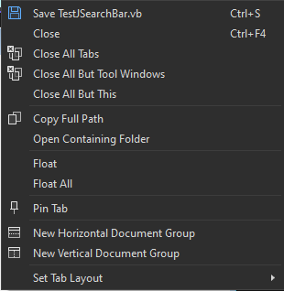
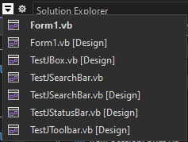
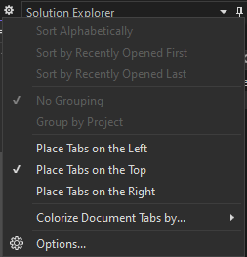
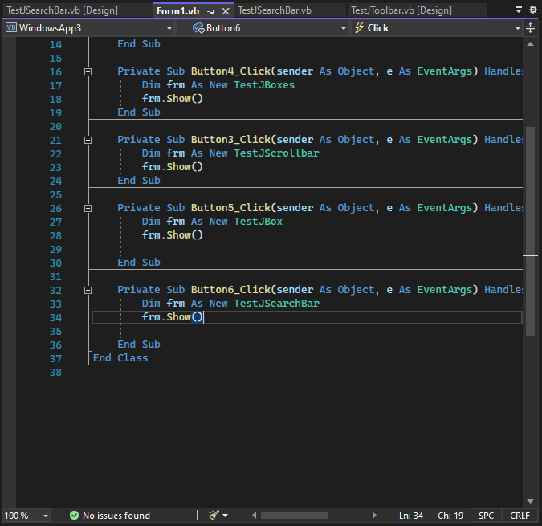
jTabBox(jBoxItem) – Design Ideas
UnFocused
Overflow Tab List
Group Box Settings
Tab Context Menu
Focused
Client Area
jBoxClientItem

Slide 10
jBoxClientItem – Design Ideas
Child Objects are responsible for:
Toolbar needed
Searchbar needed
Statusbar needed
Scrollbar needed

Slide 11
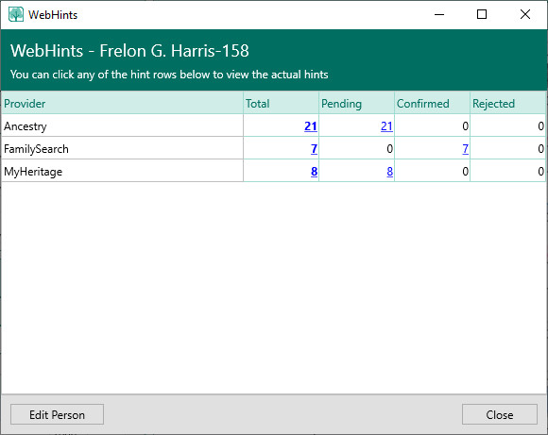

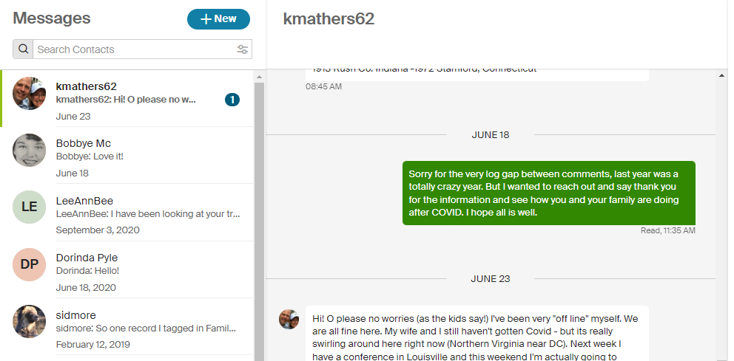
Integrations
Hints
Ancestry Messages
<li><a href="https://www.ancestry.com/connect/messagecenter/folder/inbox/" class="navLink navMessages calloutTriggerNoArrow calloutTrigger link initialized hasCount" id="navMessages" aria-controls="navMessagesMenu" aria-expanded="false" data-tracking-name="Messages" data-ui-id="ui1657379452571717"><span aria-hidden="true" class="icon iconEmail"></span><span class="hideVisually" id="navTitleMessages">Messages.</span> <span class="badge badgePositioned lightRedDot" id="navMessagesCount"></span></a></li>

Slide 12
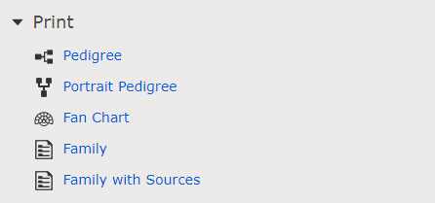
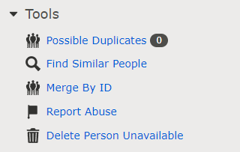

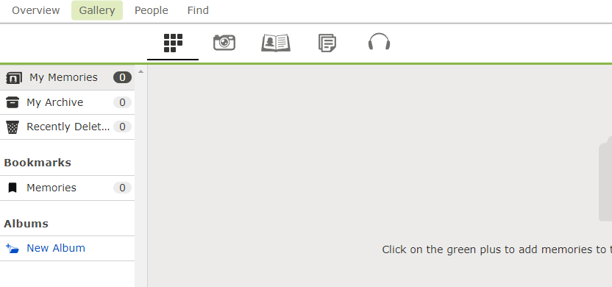
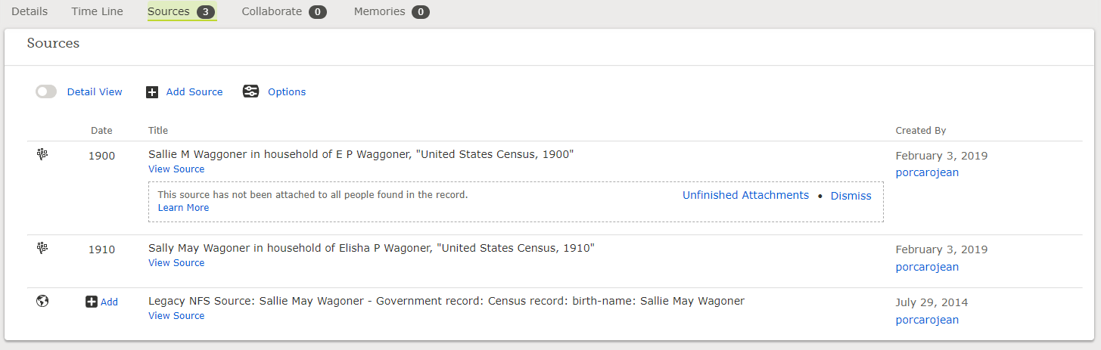

Slide 13
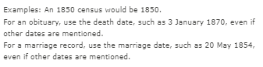
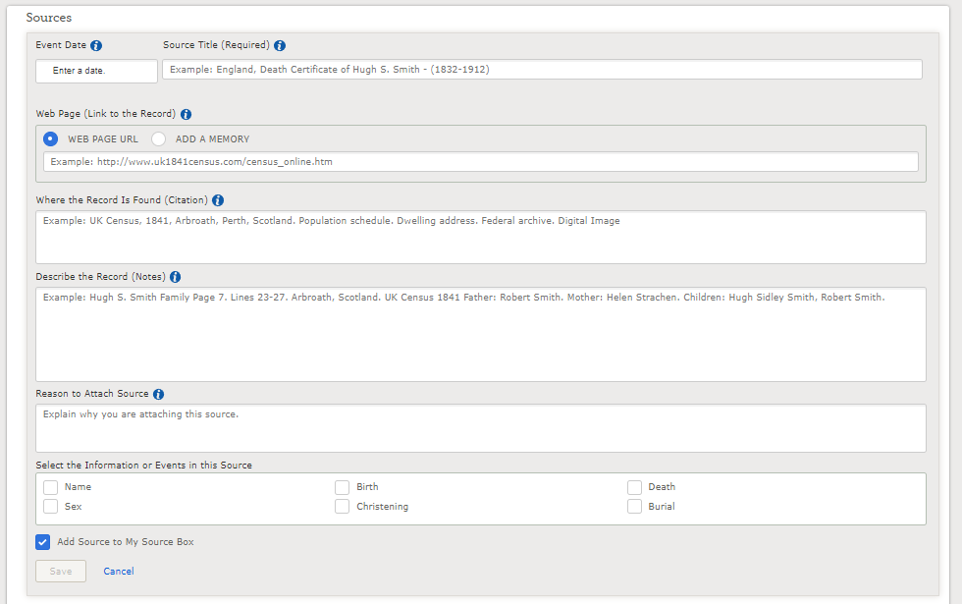
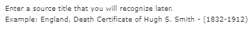
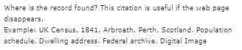
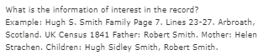

Slide 14
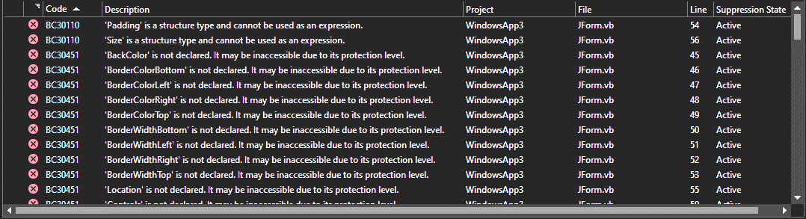
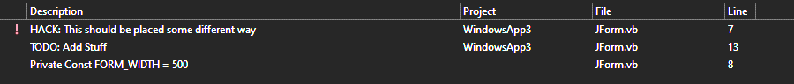
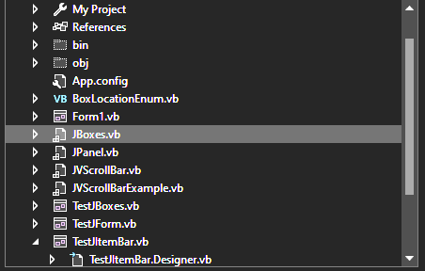
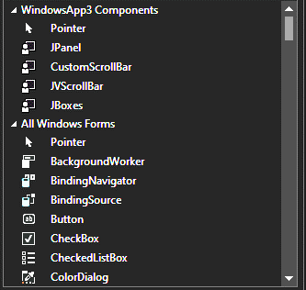
jTable – Design Ideas
jTreeView – Design Ideas

Slide 15
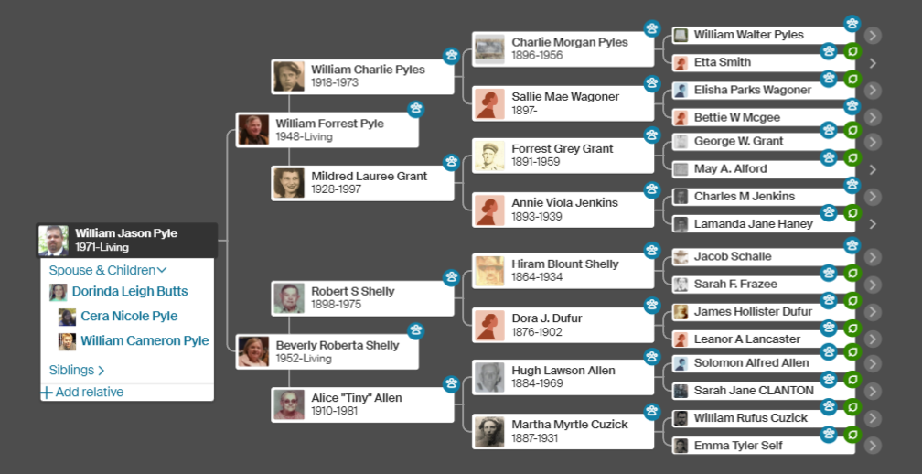
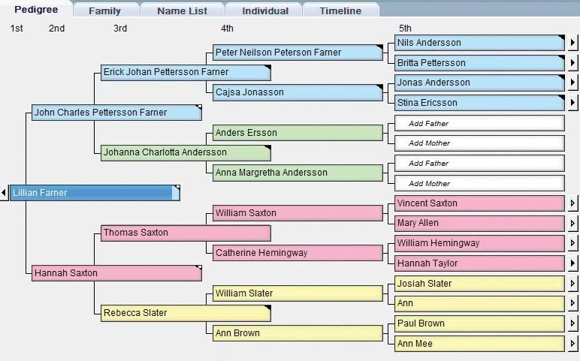
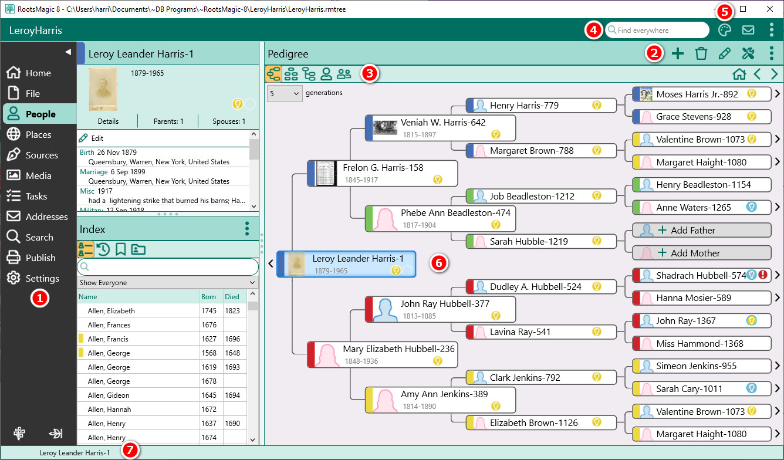
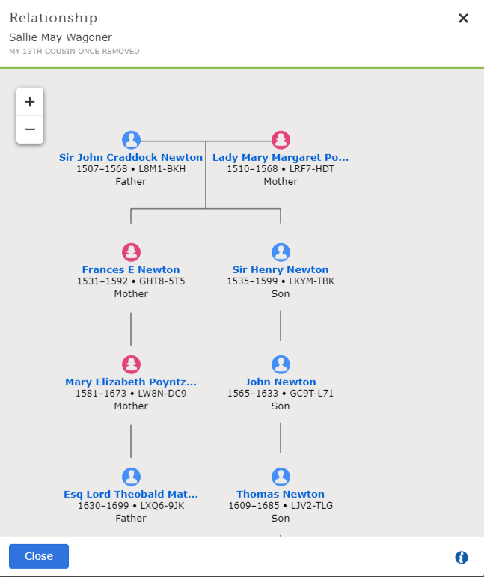
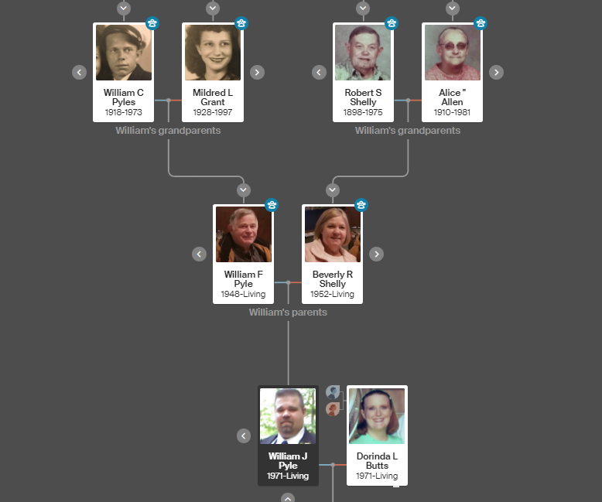
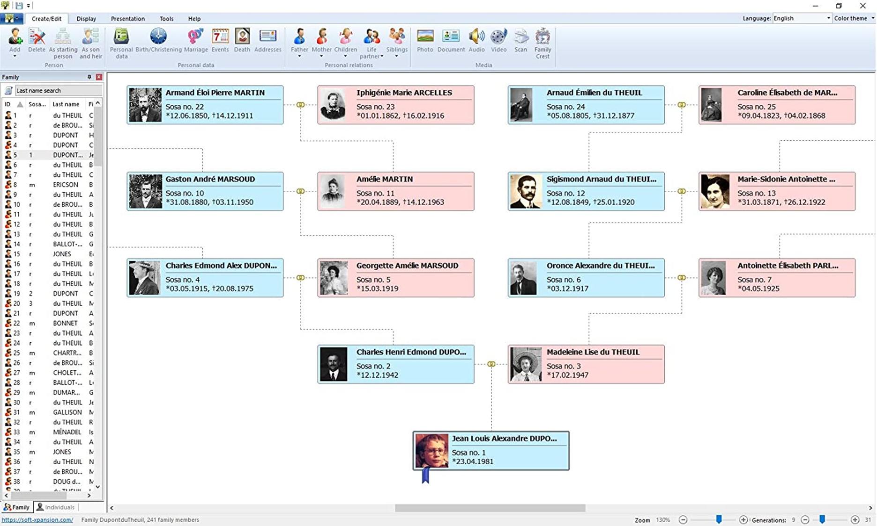
jFamilyTree – Design Ideas
PedigreeView
AncestryView

Slide 16
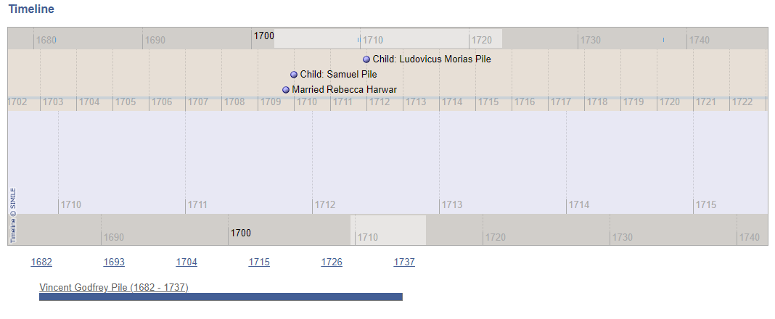
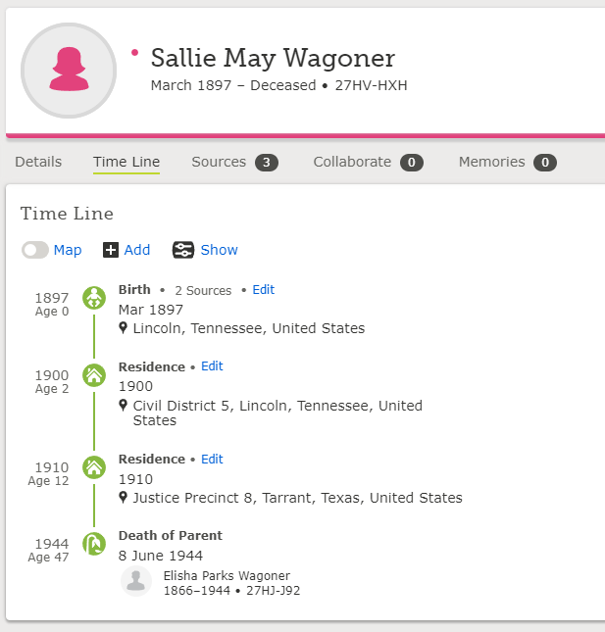
jTimeline – Design Ideas

Slide 17
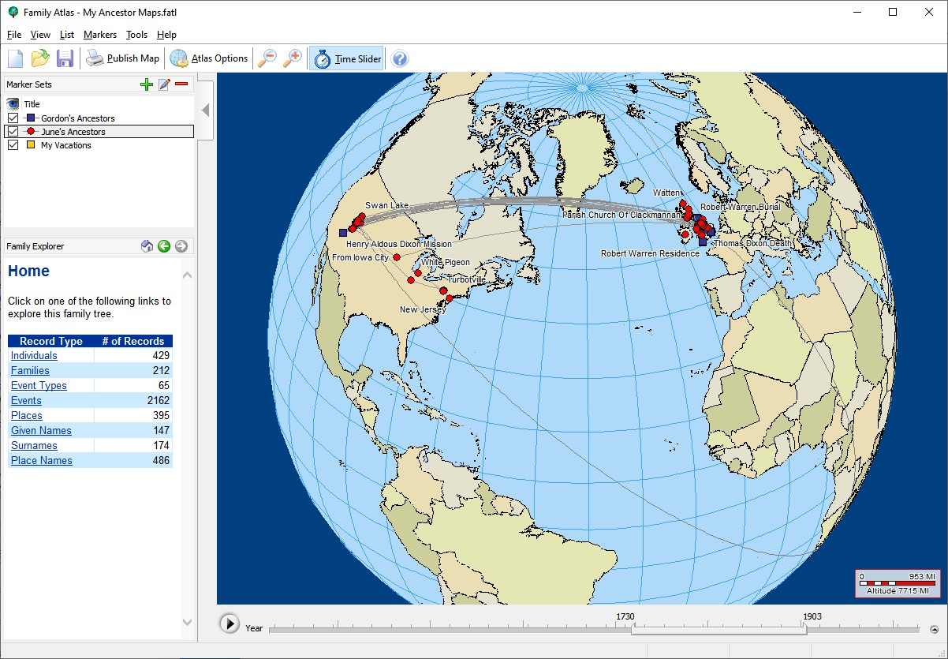
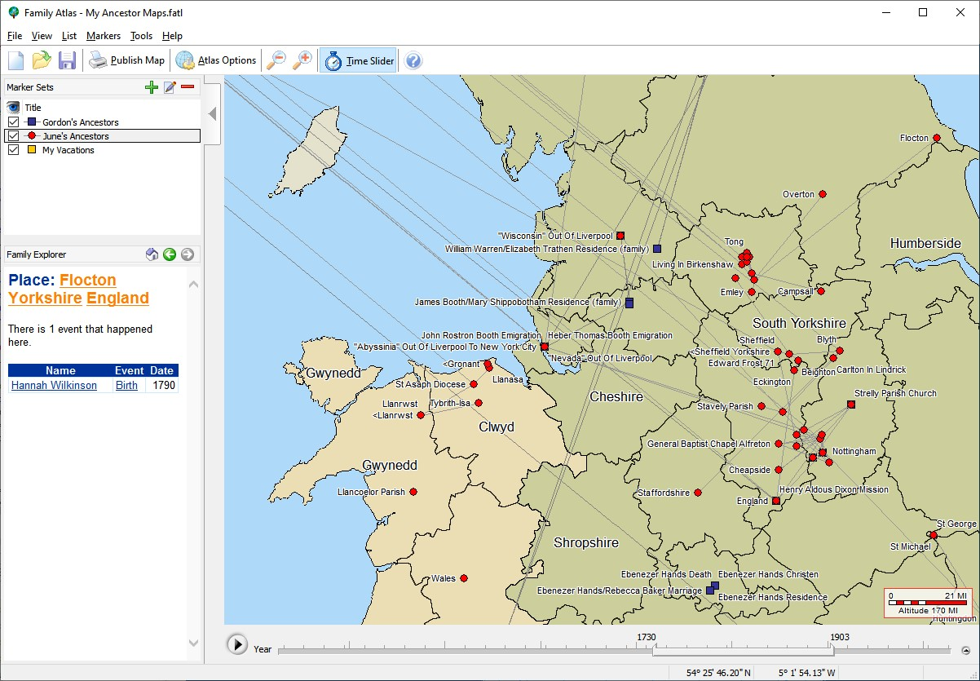
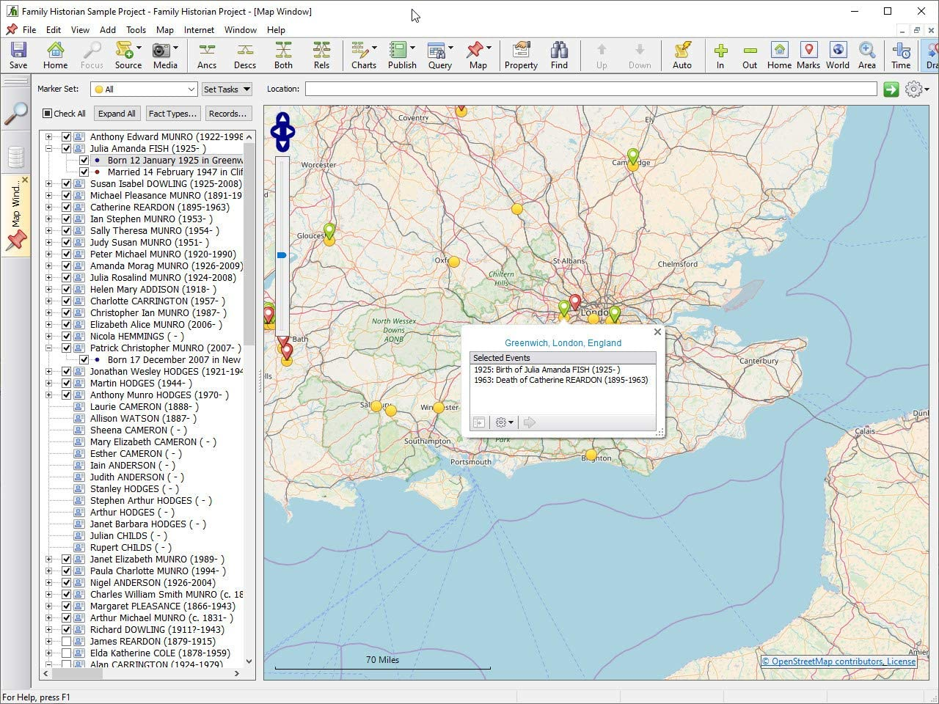
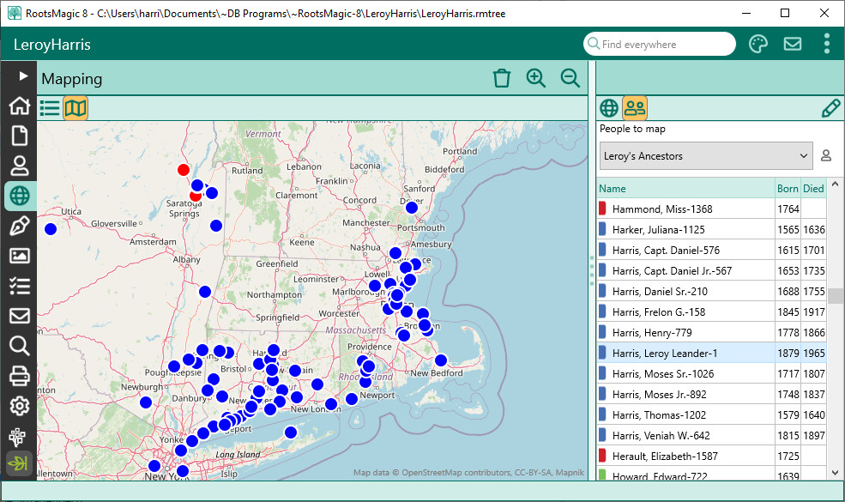
jMap – Design Ideas

Slide 18
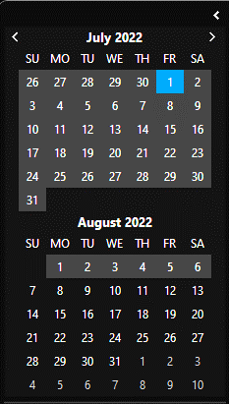
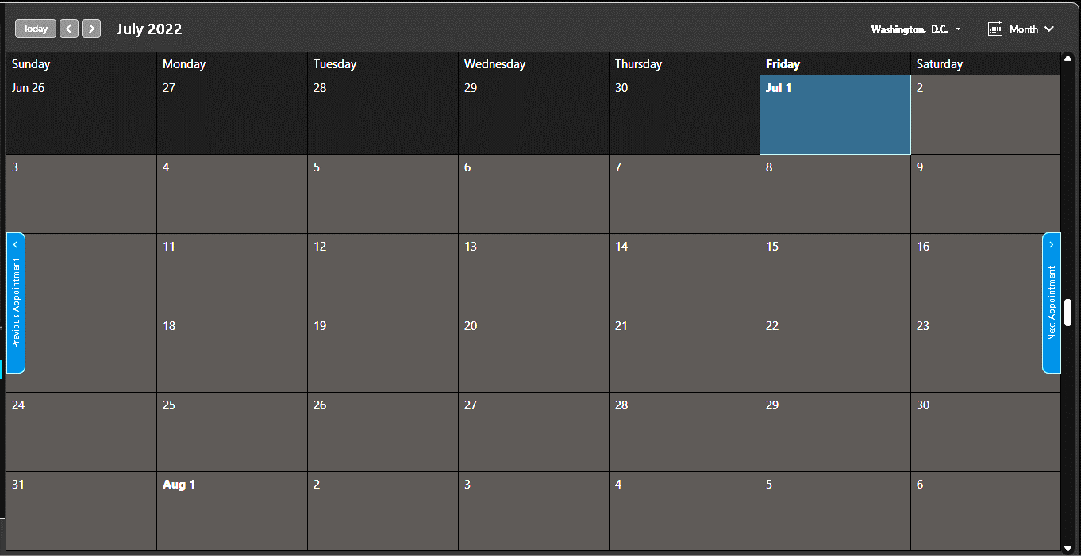
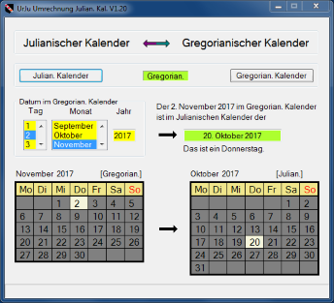
jCalendar – Design Ideas

Slide 19
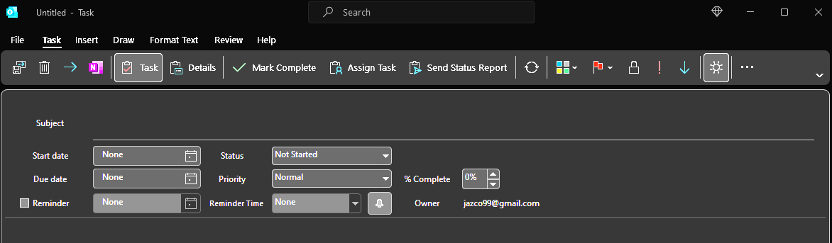
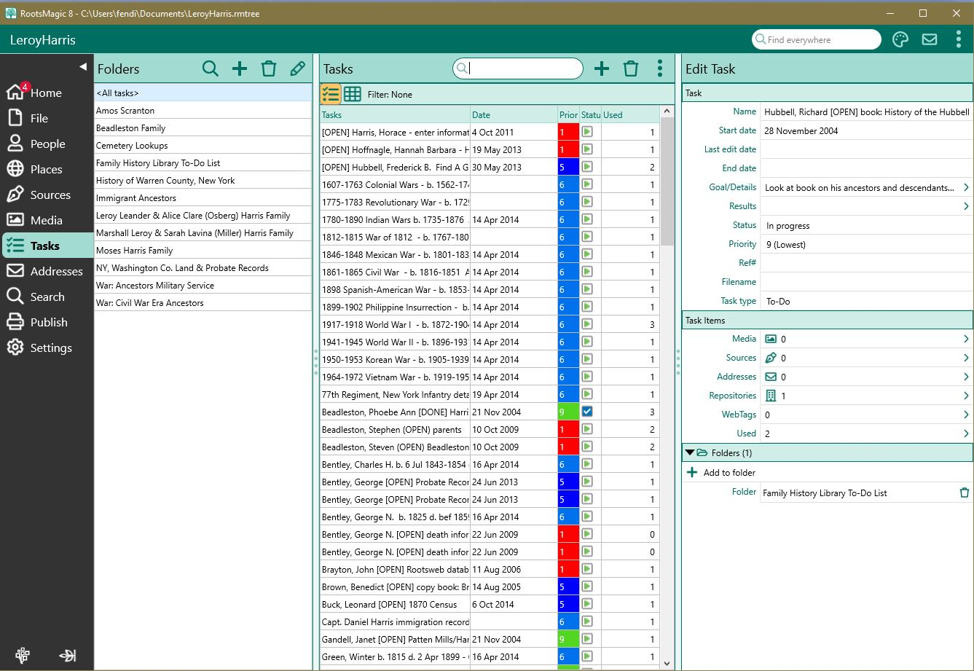
jTask – Design Ideas

Slide 20
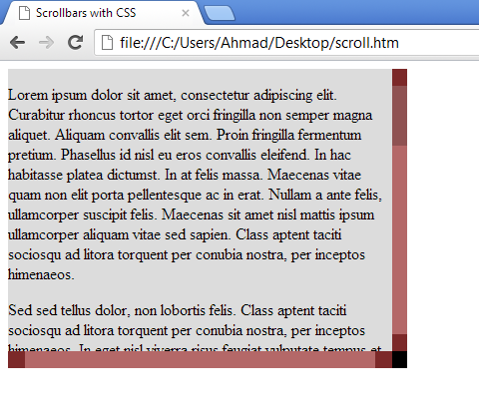
Here is a complete list of all the new pseudo-elements.
All of these pseudo-elements must be prefixed with -webkit-.
scrollbar
scrollbar-button
scrollbar-track
scrollbar-track-piece
scrollbar-thumb
scrollbar-corner
resize
Each of these objects can be styled with borders, shadows, background images, and so on to create completely custom scrollbars that will still honor the settings of the operating system as far as button placement and click behavior.
::-webkit-scrollbar {
width: 13px;
height: 13px;
}
:horizontal – The horizontal pseudo-class applies to any scrollbar pieces that have a horizontal orientation.
:vertical – The vertical pseudo-class applies to any scrollbar pieces that have a vertical orientation.
:decrement – The decrement pseudo-class applies to buttons and track pieces.
:increment – The increment pseudo-class applies to buttons and track pieces.
:start – The start pseudo-class applies to buttons and track pieces. It indicates whether the object is placed before the thumb.
:end – The end pseudo-class applies to buttons and track pieces. It indicates whether the object is placed after the thumb.
:double-button – The double-button pseudo-class applies to buttons and track pieces.
It is used to detect whether a button is part of a pair of buttons that are together at the same end of a scrollbar.
For track pieces it indicates whether the track piece abuts a pair of buttons.
:single-button – The single-button pseudo-class applies to buttons and track pieces.
It is used to detect whether a button is by itself at the end of a scrollbar.
For track pieces it indicates whether the track piece abuts a singleton button.
:no-button – Applies to track pieces and indicates whether or not the track piece runs to the edge of the scrollbar,
i.e., there is no button at that end of the track.
:corner-present – Applies to all scrollbar pieces and indicates whether or not a scrollbar corner is present.
:window-inactive – Applies to all scrollbar pieces and indicates whether or not the window containing the scrollbar is currently active.

Slide 21
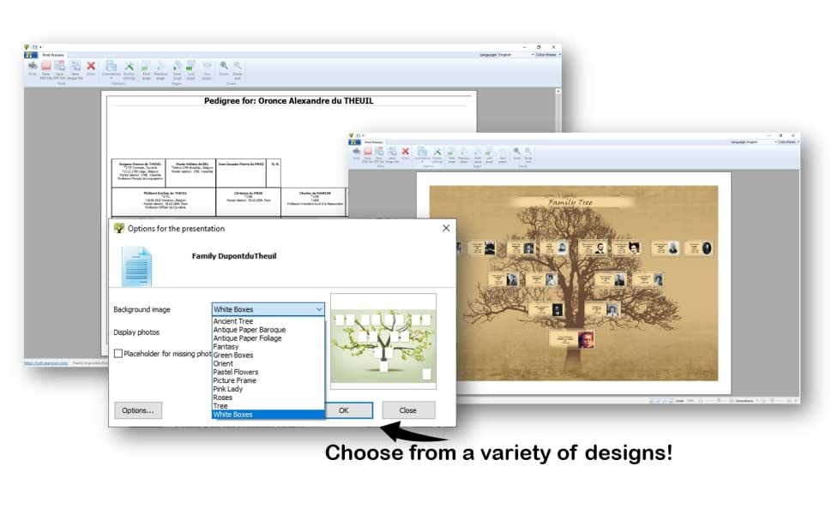
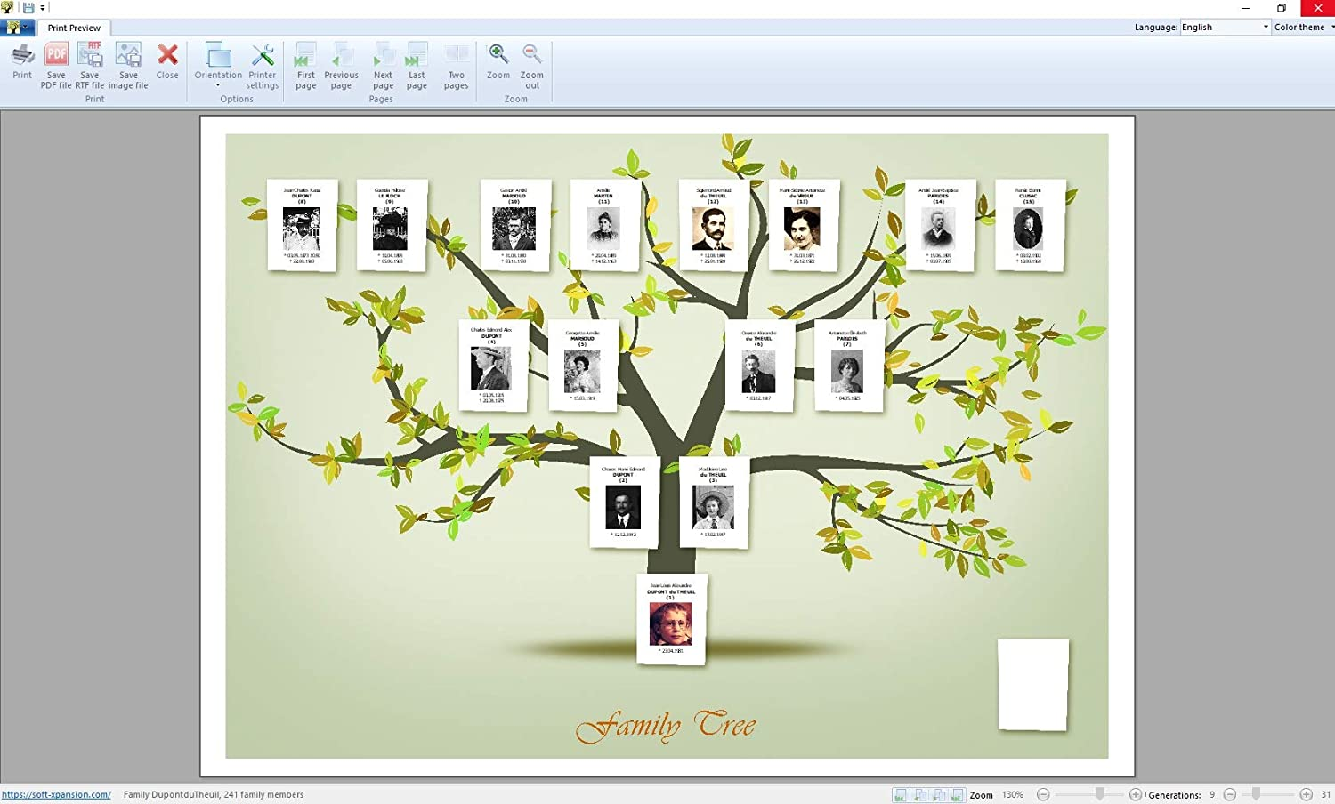
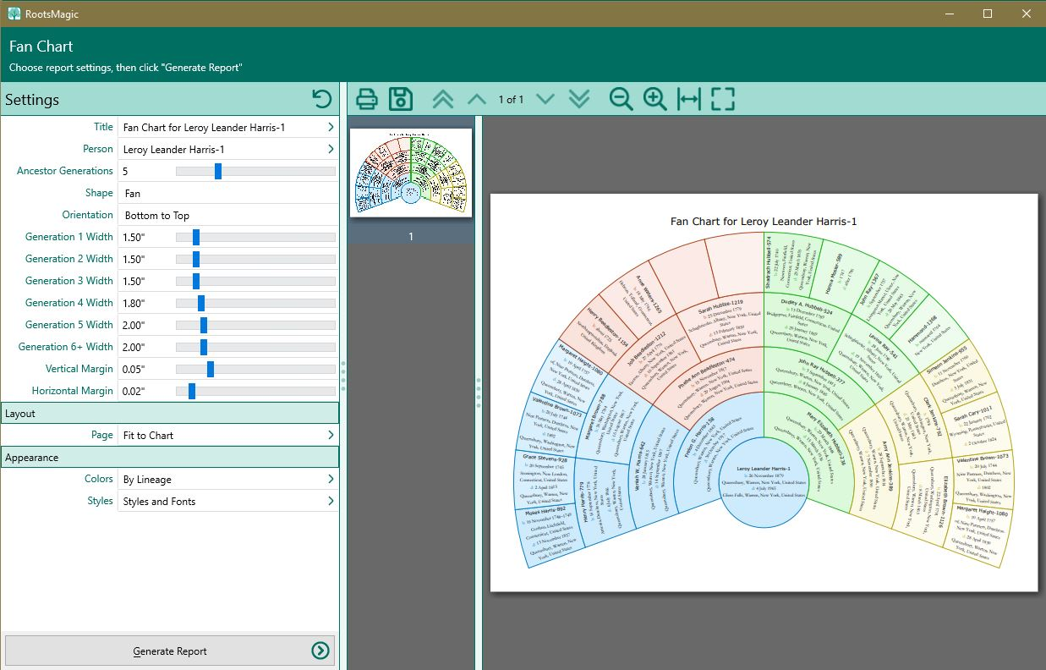
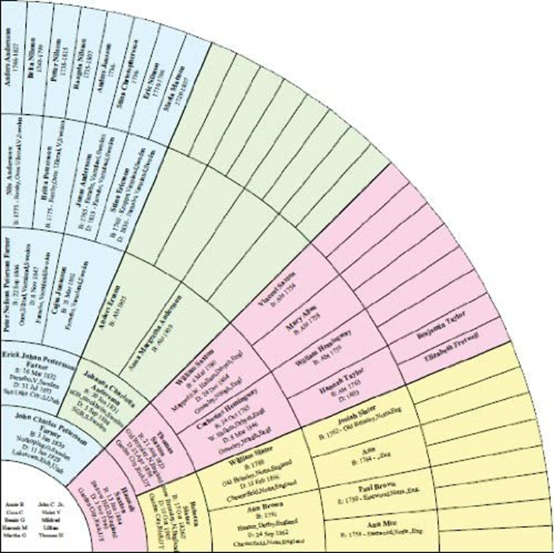
jPublish – Design Ideas

Slide 22
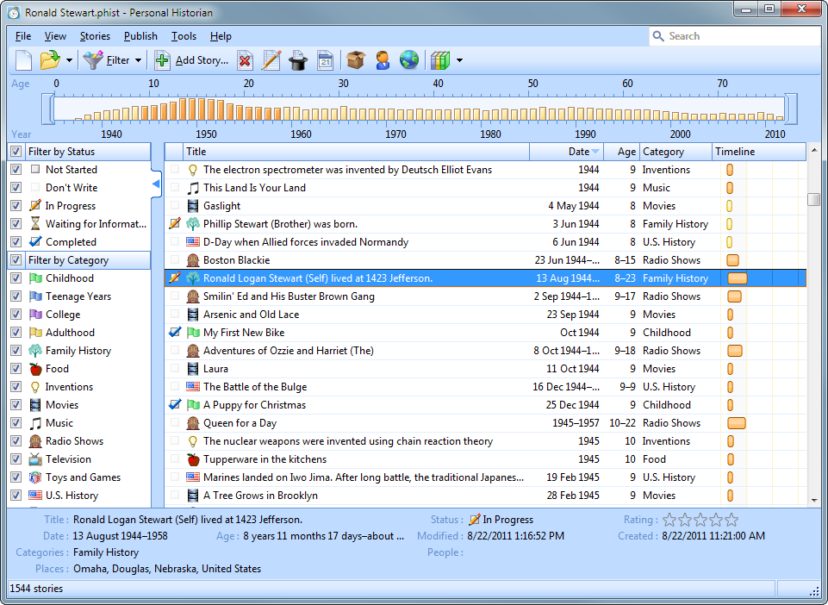
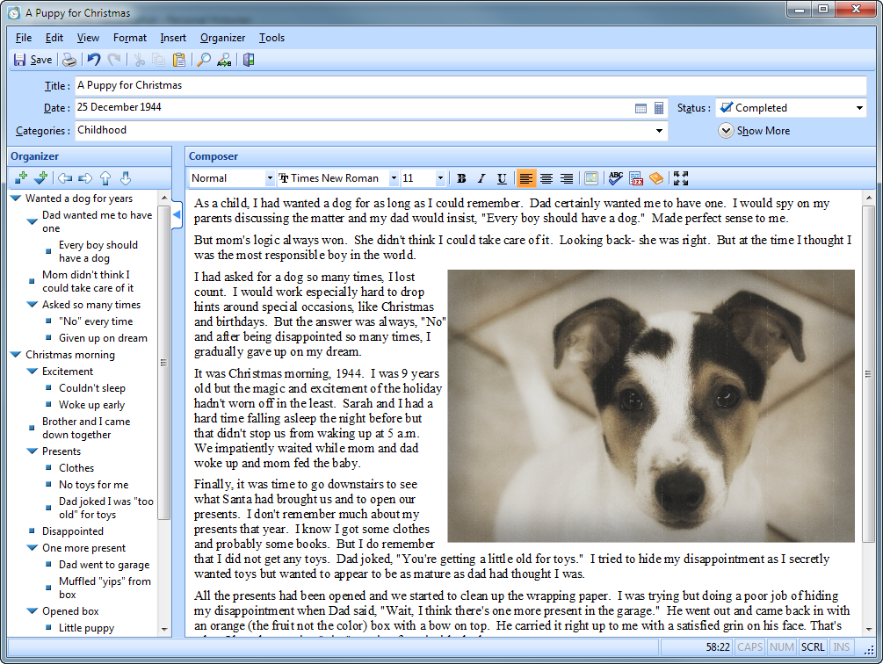
App Ide– Stories/Events

Slide 23
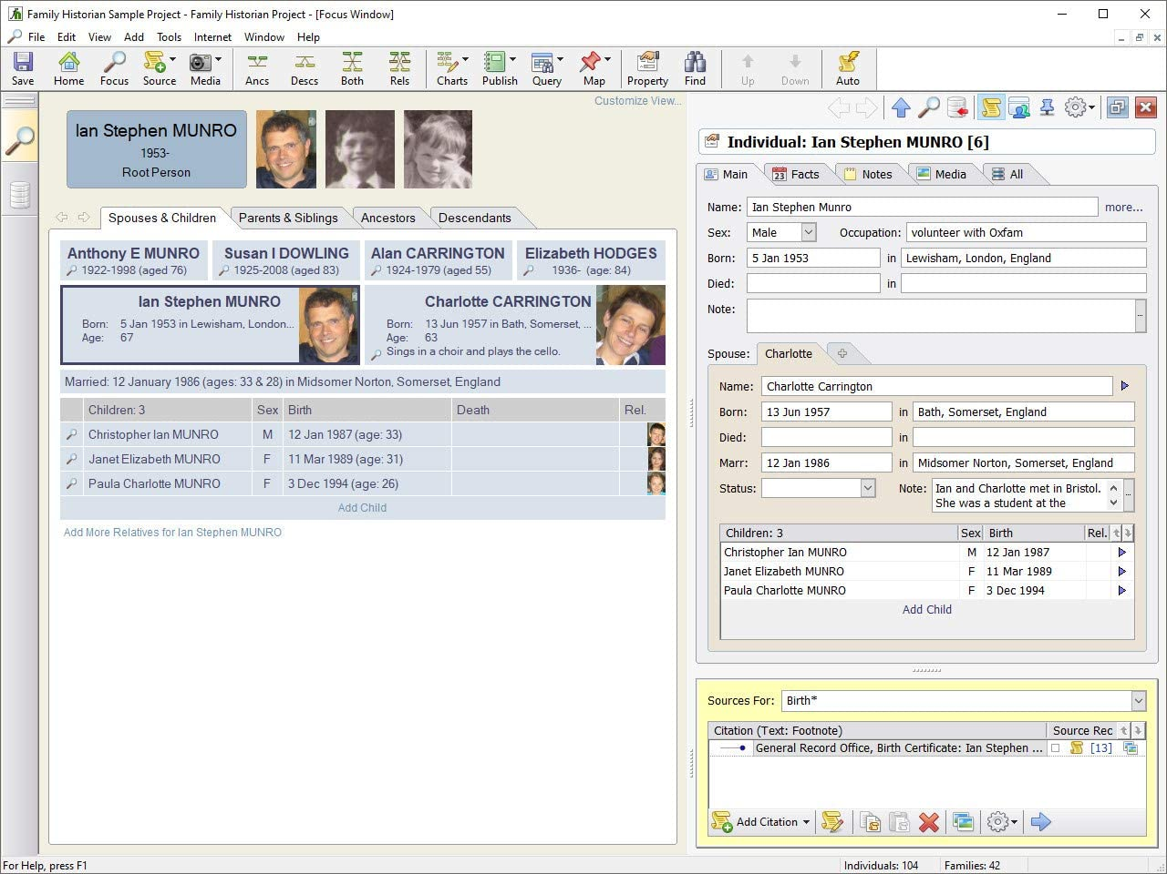
App Ide– Individual Layout

Slide 24



App Ide– Media Viewer/Editor

